Slide 1
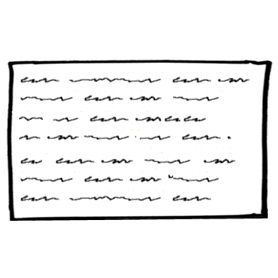

Thank you!!!! :)
Your text goes here …
As Edgar Smith (2012) explains…
Notes:
Refresher

Slide 2
As Kellen West (2011) explains…
“
“i” (p. 32).
Notes:
Model for direct quotation. Did not use.

Slide 3
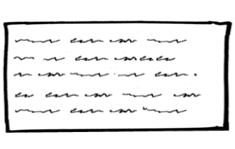
As Kellen West (2011) explains…
Notes:
GP1

Slide 4
As Tara Browning (2016) explains…
Notes:
GP2

Slide 5
As Paula Martinez (2015) explains…
Notes:
GP3

